Slide 1

Software Testing
Quality Assurance
Instructor: Kaveh Eshraghian

Slide 2
Overview
QA Definition
Agile Projects
Themes / Epics / Issues / User Stories
Kanban Boards
Test Plan / Test Strategy
Jira

Slide 3
Quality Assurance
Definition:
Any systematic process of determining whether a product or service meets specified requirements, standards and is of high quality.
Reviewed Components:
Requirements
Design
Coding
Documentation
Notes:
In the early days of software development, quality assurance was almost overlooked. If the program worked and met minimal standards it was considered good enough. Over the years, software has grown larger, more complicated, and has been integrated into many aspects of our lives. Whereas in the early days software was run by professionals who could work around the many glitches that were found, as software migrated to use by the general population, it had to be of much higher quality.

Slide 4
Agile vs. Traditional Projects
Traditional project management characteristics:
Driven by due dates.
Laid out in terms of deliverables and dates assigned to each one.
Typically done using something like a Gantt chart.
Traditional project management Issues:
Inflexible so that any unexpected event would require a complete rescheduling.
Unable to break down complicated deliverables.
Notes:
Traditional project management was driven by due dates. The project was laid out in terms of deliverables and dates assigned to each one. This was typically done using something like a Gantt chart where you could show what work could be conducted in parallel or what work was dependent on other work being finished first.
There were two problems with this approach.
The first was that it was inflexible so that any unexpected event in the preparation of a deliverable would require a complete rescheduling of all deliverables after that.
The second problem was that if a deliverable turned out to be more complicated than initially thought, there was no way to easily break it down into smaller units of work.

Slide 5

Agile Projects
Much more flexible
Breaks projects into
Themes or initiatives,
Epics or projects
Tasks or issues
Notes:
The agile approach to project management has a much more flexible way of breaking down the tasks that need to be done to complete a project. Agile breaks down a project into themes or initiatives, epics or projects, and tasks or issues. We will explore each of these below.

Slide 6
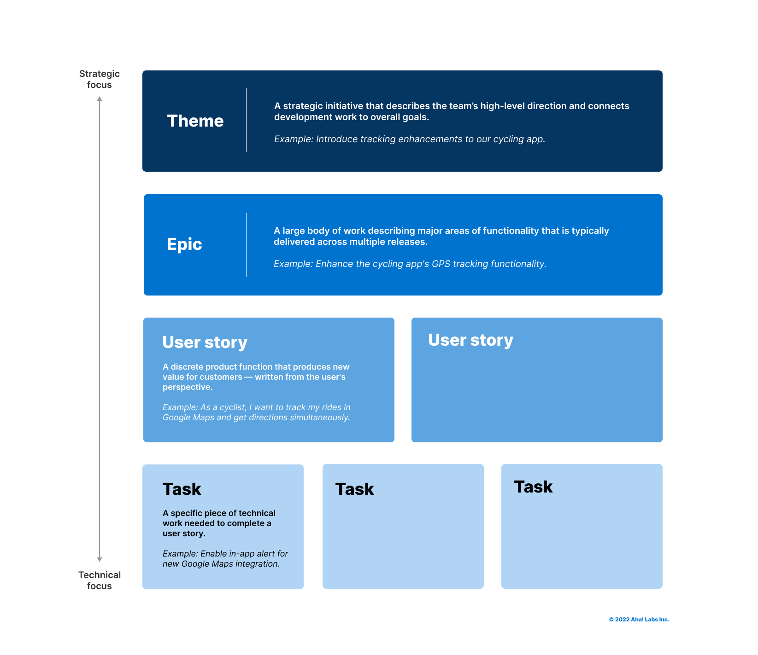

Slide 7
Themes
Definition:
A wide area of focus that helps an Agile team to keep track of their organizational goals
Description:
One of the major goals
A long-term objective that is a major and significant component of the project.
AKA, a major strategic business objective.
Notes:
A theme is one of the major goals of the project. It is usually a long term objective that is a major and significant component of the project. A theme can also be viewed as a major strategic business objective.
For example, if you decide you want to break into the project management software market then this would be the theme of your project. Of course, a theme is too broad an objective and it needs to be broken down into smaller, more manageable objectives.

Slide 8
Epics
Definition:
A large body of work that constitutes one of the main components of a theme
Characteristic:
Measurable
Level of organization between broader themes and individual user stories.

Slide 9
Issues
Definition:
An issue represents an action that must be done in order to achieve larger goals within project (Epics).
Characteristics:
One of the tasks that needs to be completed as part of an epic.
Can be a task, bug, feature
A small enough task that it can be performed in a few days or a week. (sprint)
Notes:
An issue it is one of the tasks that needs to be completed as part of an epic. An issue is a small enough task that it can be performed in a reasonable amount of time, say a few days or a week. Issues are readily actionable which means that you can easily do work to complete them

Slide 10
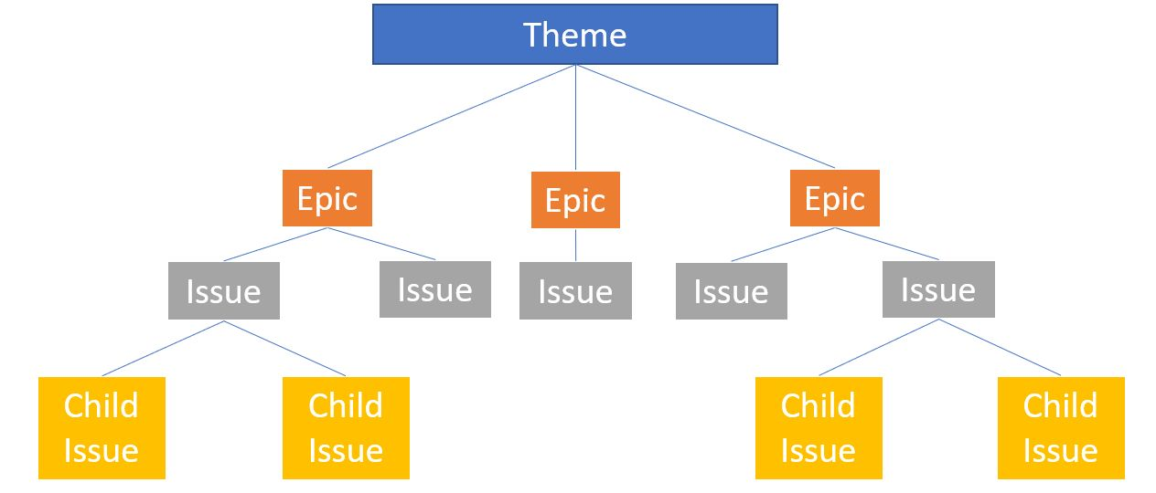
Agile Project Breakdown

Slide 11
User Stories
Definition:
A discrete product function or benefit that creates new value for customers.
Characteristics:
Same as product features
Written from user’s perspective
keep the developers informed of the importance of what they're working on
Importance:
They convey the user's perspective to developer
Template (User Story):
As a [type of user], I want to [perform some task] so that I can [achieve some goal].
Notes:
In the traditional management process, individual tasks were created based upon the technical needs of the project and contained lots of details of the technical work that needed to be performed. The problem with this was that it missed the big picture. The developer did not see how this small work item fitted into the larger picture and what functionality it was going to deliver to the end user.
The user story is a small piece of work that represents some kind of functionality that the end user wants implemented. The implication is that rather than building technical details, we now build units of functionality that are needed by the end user.
You should write your user stories so that they define when the story is done. In other words, they should make it obvious when this task is complete and they should contain something that tells us how we can test to determine when the task has finished.

Slide 12
User Stories (INVESTable)
Independent
The story should not depend on other stories and can be completed on its own,
Negotiable
It should open a conversation with the customer to invite refinement and change,
Valuable
It should provide significant value to the project,
Estimable
It should be estimated to be the right size for an issue,
Small
It should be able to be completed in a few days,
Testable
It should have clear acceptance criteria so tests can be written to verify it.

Slide 13
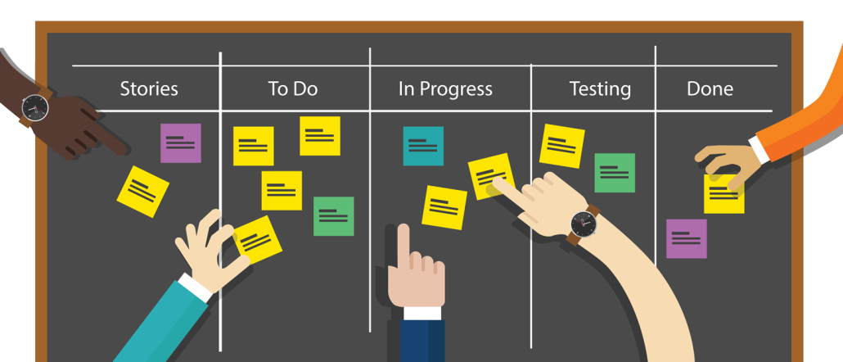
Kanban Boards
Notes:
A Kanban board displays the progress of our project as three or more columns. At its simplest, a Kanban board has a list of requested issues in the first column, issues which are in progress in the middle column, and issues which are completed in the right column.
The first Kanban board was developed in the 1940s for Toyota automotive in Japan.
Kanban is an inherently visual display of the progress of work in a system.
The columns represent the steps in the overall process and the position of items in the columns allows you to visually see exactly where things are on their way through the process. By adding columns to the Kanban board, you will be able to tailor the board to the software process you are using.
One of the things you can use a Kanban board for is to limit the amount of work in progress. Many of the tools that use the Kanban method allow you to put a limit on the number of issues which can be placed in any of the in-progress columns. This is to ensure that your team is not overloaded by having too many issues in progress at the same time.

Slide 14
Software Test Plan
Definition: (As per ISTQB)
Test Plan is A document describing the scope, approach, resources, and schedule of intended test activities.
Goal:
Helps us determine the effort needed to validate the quality of the application under test.
Serves as a blueprint to conduct software testing activities as a defined process.
The instruction manual for the testing process

Slide 15
Software Test Plan
The test plan should include:
A description of how the testing will be performed at a particular level,
The objectives of the testing which should describe what is being tested and what this will prove,
the scope of the testing which will determine what parts of the software are being tested as well as what parts are not being tested,
A schedule of when the tests will be conducted and the order of the tests,
A list of risks in the project and how they can be mitigated,
A list of the hardware and software resources necessary to conduct the testing,
A list of the roles and skills of the people required to do the testing.

Slide 16
Test Strategy
Definition:
A short document which is often written before the test plan.
Purpose:
define the major test objectives and to make sure that the test aligns with the organizational needs
Includes:
A description of what makes this project unique
A description of the SuccessFactors that are being tested,
Risks involved to the business the project the product, etc,
The roles and responsibilities of the people who will conduct the test,
A rough schedule of the test,
The level of the test for example component testing integration testing or system acceptance testing,
The type of testing to be performed whether it be functional testing, security testing, usability testing or some other type.

Slide 17
Test Plan Layout
Introduction
A list of test objectives
The scope of the testing
A system overview
Approach
A list of assumptions and constraints on the testing.
How the test coverage will be determined.
Software components to be validated.
Business processes to be validated.
Test Tools
A list of the testing tools that will be required
Test Type

Slide 18
Test Plan Layout
Test Plan
The people on the test team and their responsibilities.
Schedule listing the major parts of the testing.
Environment
A list and description of the hardware and software components.
Any special training needed for the testing team.
Features to be tested
A list of the features to be tested.
Features not tested.
A list of functionality that will not be tested

Slide 19
Test Plan Layout
Testing procedure
A general overview of the testing process.
The order in which the tests will be conducted.
A general description of pass/fail criteria.
Defect Management
How defects will be reported and managed.
Risks
List the risks to the project due to defects discovered during testing.
Notes:
Writing Style​
The test plan should be:
written consisely, without unnecessary verbage,
organized into logical sections, making things easy to find,
written to be readable by using lists and tables to make it easier to read the information,
be adaptable since changes will be necessary through the life of the project.

Slide 20
Jira
A software application that allows teams to track issues, manage projects, and automate workflows.
It tracks Issues might include:
Features which need to be built.
Design documents which need to be written.
Software tests which need to be written.
Software tests which need to be executed.

Slide 21
Jira Capabilities
Add users to your project,
Creating issues and placing them in one of the Kanban columns,
Assigning issues two one of the team members,
Moving issues through the Kanban columns,
Notifying team members when the status of an issue in which they are interested changes.

Slide 22
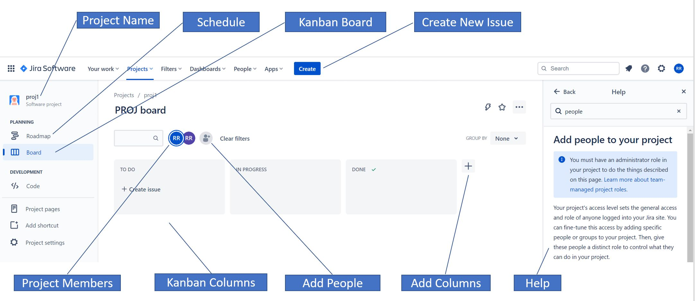
Jira Interface

Slide 23
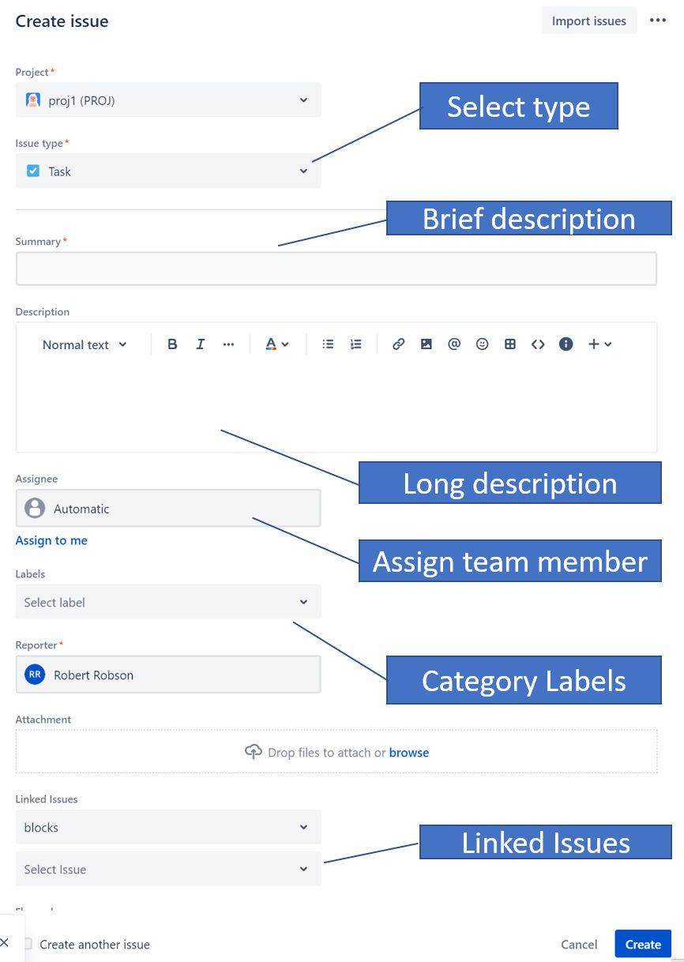
Creating Issues

Slide 24
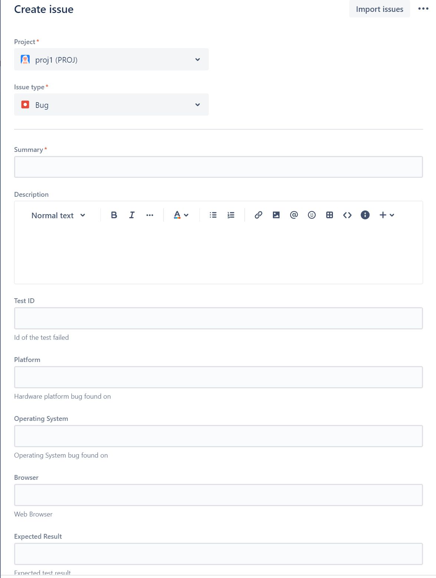
Reporting Bugs

